Slide 1

Internship Project
on
Website and Application Development for Vegetable Market Logs
Project Manager and Mentor:
Mr. Yuvraj Joshi
Assistant Professor,
Department of Computer Science & Engineering
Graphic Era Deemed to be University, Dehradun,
Uttarakhand, India (248002)

Slide 2

Machine Learning
Machine learning is a subfield of artificial intelligence (AI) that involves the development of algorithms and models that enable computers to learn and improve their performance on a specific task without being explicitly programmed for it.
Instead of relying on traditional rule-based programming, machine learning algorithms use data to identify patterns, make predictions, and make decisions.

Slide 3
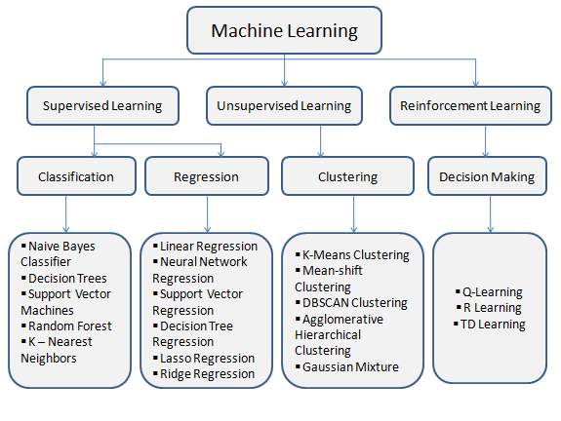

Slide 4
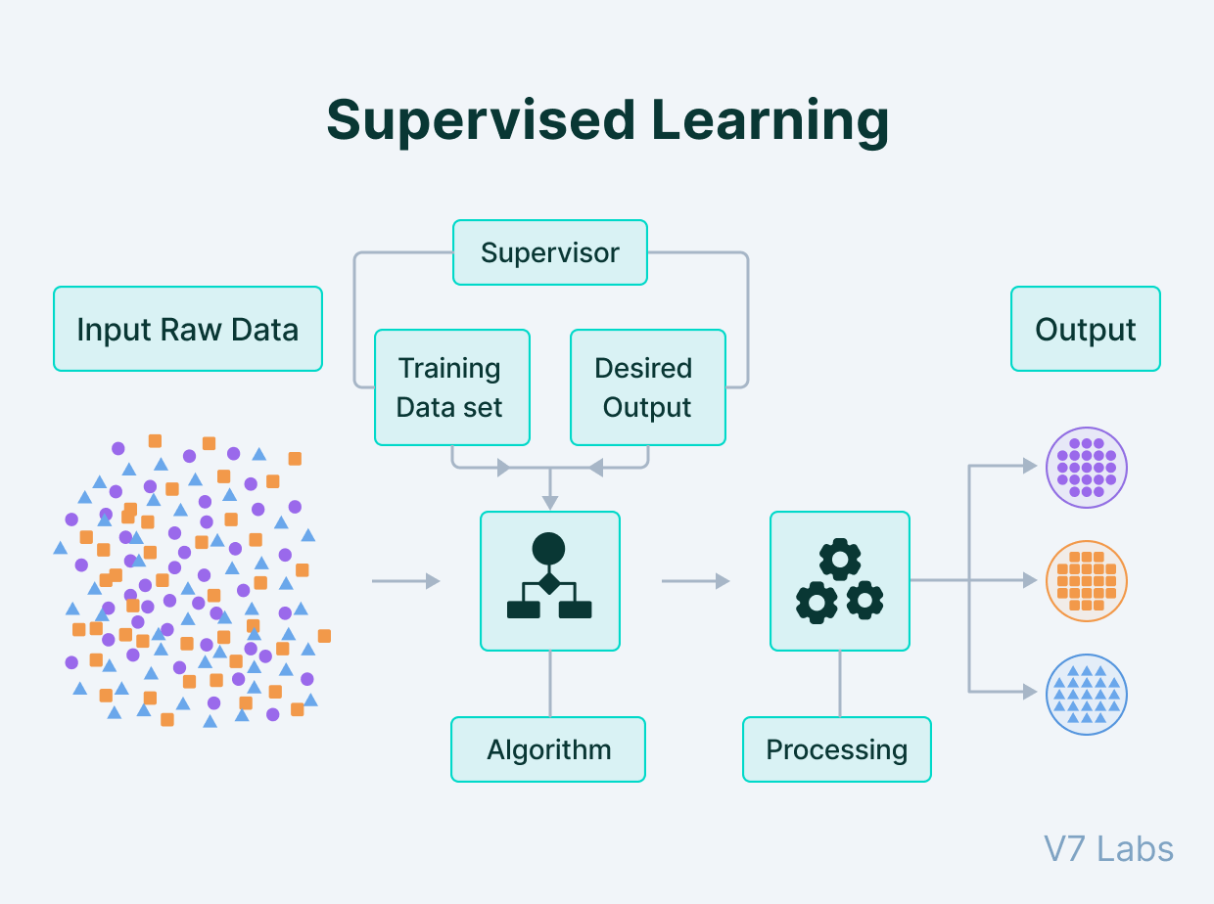
Types of Machine Learning
1. Supervised Learning:
The algorithm is trained on a labeled dataset, meaning that the input data is paired with the correct output or target. The goal is for the algorithm to learn a mapping between the input and output variables so that it can predict the output for new, unseen data. Popular algorithms in this category include:

Slide 5
Supervised Learning
Linear Regression: A simple algorithm used for regression tasks to model the relationship between the input features and the target variable using a linear equation.
Logistic Regression: Used for binary classification tasks, it estimates the probability that an instance belongs to a particular class.
Support Vector Machines (SVM): A versatile algorithm used for both classification and regression tasks that find the optimal hyperplane to separate different classes or predict numerical values.
Decision Trees: A tree-based algorithm that recursively splits the data based on the features to make predictions.

Slide 6
Supervised Learning
Random Forest: An ensemble algorithm that combines multiple decision trees to improve accuracy and reduce overfitting.
K-Nearest Neighbors (KNN): A simple and intuitive algorithm that classifies an instance based on the majority class of its k-nearest neighbors in the feature space.
Naive Bayes: A probabilistic algorithm based on Bayes' theorem, often used for text classification and spam filtering.
Gradient Boosting Machines (GBM): An ensemble technique that combines weak learners (usually decision trees) sequentially to create a strong predictive model.

Slide 7
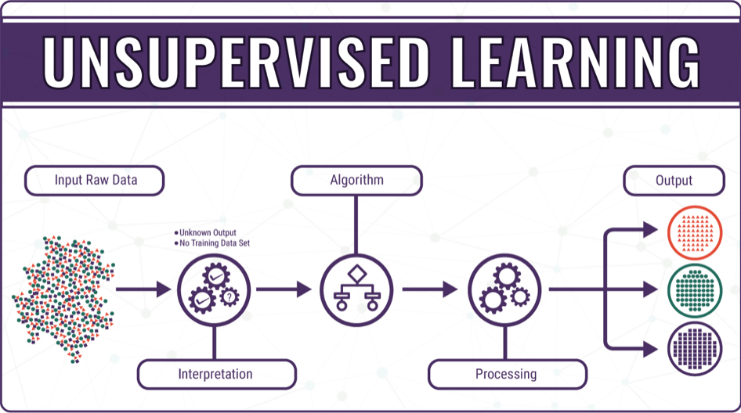
Types of Machine Learning
2. Unsupervised Learning
Unsupervised learning algorithms deal with unlabeled data and aim to find patterns or structure within the data without explicit guidance. The primary tasks include clustering and dimensionality reduction.

Slide 8
Unsupervised Learning
K-Means: A popular clustering algorithm that partitions data into k clusters based on similarity.
Hierarchical Clustering: Divides data into a hierarchical structure of clusters, creating a tree-like representation.
Principal Component Analysis (PCA): A dimensionality reduction technique that projects data into a lower-dimensional space while retaining the most important information.
Autoencoders: Neural network-based algorithms used for unsupervised feature learning and data compression.
t-Distributed Stochastic Neighbor Embedding (t-SNE): A technique used to visualize high-dimensional data by mapping it to a 2D or 3D space while preserving local structures.

Slide 9

Types of Machine Learning
3. Reinforcement Learning
In reinforcement learning, an agent interacts with an environment and learns to take actions to maximize a cumulative reward signal. The agent explores the environment and learns which actions lead to better outcomes.

Slide 10
Reinforcement Learning
Q-Learning: A model-free, off-policy algorithm used in reinforcement learning to learn the optimal action-value function.
Deep Q Networks (DQNs): A deep learning-based extension of Q-Learning, which uses neural networks to approximate the action-value function.
Policy Gradient Methods: These algorithms directly learn the policy, which defines the agent's behavior, through gradient ascent.

Slide 11
Reinforcement Learning
Proximal Policy Optimization (PPO): A popular policy gradient method used for continuous action spaces.
Deep Deterministic Policy Gradients (DDPG): Suitable for continuous action spaces, it combines deep neural networks with deterministic policies.
Monte Carlo Tree Search (MCTS): A search algorithm commonly used in games and decision-making tasks.

Slide 12
Predictive Algos…

Slide 13
Predictive Algorithms
1. Supervised Learning Algorithms (8):
- Linear Regression
- Logistic Regression
- Support Vector Machines (SVM)
- Decision Trees
- Random Forest
- K-Nearest Neighbors (KNN)
- Naive Bayes
- Gradient Boosting Machines (GBM)

Slide 14
Predictive Algorithms
2. Unsupervised Learning Algorithms (5):
- K-Means
- Hierarchical Clustering
- Principal Component Analysis (PCA)
- Autoencoders
- t-Distributed Stochastic Neighbor Embedding (t-SNE)

Slide 15
Predictive Algorithms
3. Reinforcement Learning Algorithms (2):
- Q-Learning
- Deep Q Networks (DQNs)
(there are many other machine learning algorithms and variations within each category. The mentioned algorithms are among the most common and well-established ones in their respective categories. )

Slide 16
What Algorithm could be suited for our purpose?

Slide 17
Predictive Algorithms
For making predictions for vegetable prices in an online vegetable store, the most suitable type of machine learning algorithm is Supervised Learning, as it involves training the model on labeled data, where historical data about vegetable prices is available along with other relevant features.

Slide 18
Predictive Algorithms
Among the supervised learning algorithms mentioned in the previous answer, the following ones are commonly used for regression tasks, which is appropriate for predicting continuous values like vegetable prices:
1. Linear Regression: This is a simple and interpretable algorithm that establishes a linear relationship between the input features and the target variable (vegetable prices). However, its performance may be limited if the relationship between features and prices is complex.

Slide 19
Predictive Algorithms
2. Random Forest: This ensemble algorithm is robust and can handle non-linear relationships between features and prices effectively. It tends to generalize well and is less prone to overfitting, which is important for accurate predictions.
3. Gradient Boosting Machines (GBM): Similar to Random Forest, GBM is an ensemble algorithm, but it builds trees sequentially, each one trying to correct the errors of the previous one. It often produces accurate predictions and can handle complex relationships in the data.

Slide 20
Predictive Algorithms
These algorithms can be trained on historical data that includes features such as vegetable type, season, demand, supply, and any other relevant factors influencing vegetable prices. The model can then make predictions for the prices of vegetables based on the input features of new data, allowing the online vegetable store to adjust prices accordingly.
NOTE: the performance of these algorithms will depend on the quality and quantity of the available data, the relevance and accuracy of the features, and the specific characteristics of the vegetable price data. It's always a good practice to experiment with different algorithms, fine-tune their hyperparameters, and evaluate their performance using appropriate metrics to choose the best model for a particular application.

Slide 21
What could be the best of them all?

Slide 22
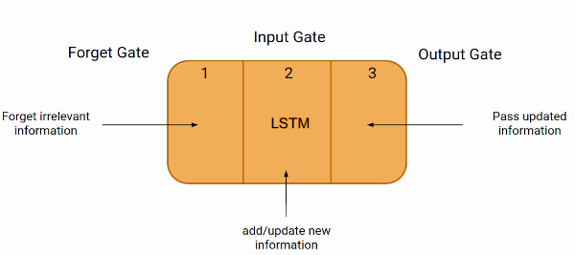
LSTM
LSTM stands for Long Short-Term Memory, and it is a type of recurrent neural network (RNN) architecture designed to address the vanishing gradient problem in traditional RNNs. The vanishing gradient problem occurs when training RNNs on long sequences, and it leads to difficulties in capturing long-term dependencies in the data.
LSTM networks introduce special memory cells that allow them to selectively retain or forget information over time, making them particularly effective for sequential data, such as time series, natural language processing, and speech recognition tasks.

Slide 23
LSTM
Let's explain LSTM using a simple example of a sentence completion task:
Imagine we want to predict the missing word in the following sentence: "The sun is shining, and the _______ is blue.“
In a traditional RNN, the network would process the sentence word by word, with each word being fed as input to the RNN cell along with the hidden state from the previous time step. However, traditional RNNs may struggle to remember relevant information from the beginning of the sentence as they process more words.

Slide 24
LSTM
In contrast, an LSTM network can effectively handle long sequences. It achieves this through three fundamental components:
Cell State (C_t): The cell state is the core of the LSTM. It acts as a conveyor belt that runs through the entire sequence, allowing information to flow through the network without being heavily affected by the vanishing gradient problem. The cell state is responsible for maintaining long-term dependencies in the data.
Input Gate (i_t): The input gate decides how much new information should be added to the cell state. It takes the current input and the previous hidden state as input and outputs a value between 0 and 1, indicating the amount of new information to keep.
Forget Gate (f_t): The forget gate determines what information to discard from the cell state. It decides how much of the previous cell state to forget. Like the input gate, it takes the current input and the previous hidden state as input and outputs a value between 0 and 1 for each element in the cell state.

Slide 25
LSTM
To complete our example, let's see how the LSTM processes the sentence:
"The sun is shining, and the": LSTM takes "The" as input, processes it through the input gate and forget gate, updates the cell state, and calculates the output for this time step.
"The sun is shining, and the _______": LSTM takes "sun" as input along with the previous hidden state and cell state, processes it through the input gate and forget gate, updates the cell state, and calculates the output.
The LSTM continues this process for each word in the sentence, taking into account the input, the previous hidden state, and the cell state at each time step. Finally, it predicts the missing word based on the learned patterns in the sequence.
NOTE: LSTM's ability to maintain and control information flow over long sequences makes it suitable for various tasks, including language modeling, sentiment analysis, machine translation, and many others involving sequential data.

Slide 26
Can this be Implemented on our Project?

Slide 27
LSTM
Yes, you can use Long Short-Term Memory (LSTM) networks for predicting vegetable prices in an online vegetable store. LSTM is a type of recurrent neural network (RNN) that is particularly well-suited for sequential data, such as time series data, where there is a dependence on past observations to make predictions about the future.
Predicting vegetable prices can be treated as a time series forecasting problem, where the historical prices and other relevant factors are used to predict future prices. LSTM can capture the temporal dependencies in the data and learn patterns and trends that might influence the prices.

Slide 28
LSTM
LSTM for predicting vegetable prices:
Data Preparation: Organize your historical data into a time series dataset, with timestamps and corresponding vegetable prices. You can also include other features like weather conditions, holidays, or demand and supply data.
Data Preprocessing: Normalize or scale the data to a similar range to help the LSTM model converge faster during training. Divide the dataset into training and testing sets, ensuring that the test set contains future time steps that the model needs to predict.
Model Architecture: Design the LSTM model, which will have one or more LSTM layers followed by fully connected layers for prediction. The number of LSTM layers and the number of units in each layer can be tuned based on the complexity of the problem.

Slide 29
LSTM
4. Training: Train the LSTM model on the training data using an appropriate loss function (e.g., mean squared error) and an optimizer (e.g., Adam). During training, the LSTM will learn to capture patterns and trends in the historical data.
5. Prediction: After training, use the model to make predictions on the test set, which contains future time steps. Evaluate the model's performance using metrics like mean squared error, mean absolute error, or root mean squared error.
6. Adjustment and Refinement: Based on the evaluation results, you can fine-tune the model, adjust hyperparameters, or modify features to improve the prediction accuracy.
NOTE: the effectiveness of the LSTM model will depend on the availability and quality of data, the choice of features, and the complexity of the price patterns. It's essential to experiment with different architectures and hyperparameters to find the best-performing model for your specific vegetable price prediction task. Additionally, incorporating other time series forecasting techniques like ARIMA (AutoRegressive Integrated Moving Average) or Prophet could also be considered for comparison.

Slide 30
<thanks/>

